Slide 1

Session 7 – Python
Brief Intro to Machine Learning with Scikit Learn
Review of Classifiers and Summation Project
Doug Bowman

Slide 2
STOPPED HERE

Slide 3
Classifiers Review
Overview
  Gathering Data
  Preparing Data
  Scaling Data
  Classifiers Review
  Metrics
  Example Classifier Project
  Project

Slide 4
Classifiers Review
Gathering Data
  Web Data
    HTML can be collected using urllib and Beautiful Soup
    XML can be collected using urllib and Beautiful soup, and parsed via xml.etree.ElementTree

Slide 5
Classifiers Review
Gathering Data
  CSV Data
    Can treat as a .txt file
      Parse manually, using “,” as a delimiter
      Parse using csvreader class
      Load into Pandas dataframe

Slide 6
Classifiers Review
Gathering Data
  CSV Data
    If treating as a normal text file, remember there is no real standard for CSV
      Elements with commas in them may cause trouble

Slide 7
Classifiers Review
Gathering Data
  CSV Data
    If treating as a normal text file, remember there is no real standard for CSV
      Sometimes, elements are encapsulated with double-quotes
      Sometimes only elements with commas in them are encapsulated with double-quotes

Slide 8
Classifiers Review
Gathering Data
  Excel Data
    Load into Pandas dataframe using read_excel()
    Use xl_wings to read Excel

Slide 9
Classifiers Review
Gathering Data
  SQL Data
    Read data into a Pandas dataframe using from_sql()
    Need a connection string detailing how to connect to your applicable database
    Need a command text with the SQL query on what data to pull

Slide 10
Classifiers Review
Gathering Data
  SQL Data
    Database examples using the file path as the connection string:
      SQLite
      Access
      NoSQL

Slide 11
Classifiers Review
Gathering Data
  SQL Data
    Database examples of databases requiring a multi-parameter connection string:
      Microsoft SQL Server
      SAP
      MySQL
      Maria DB
      Oracle
      Postgres SQL

Slide 12
Classifiers Review
Preparing Data
  Check data for type consistency
    If there is a column of integers, and one is a string, that will cause issues when you try and train your model
  Check data for empty cells

Slide 13
Classifiers Review
Preparing Data
  Check data for values that are way out of the range of the rest of the data
    May be an error
    May be an outlier
    You may want to remove if it is an outlier to get a more accurate model

Slide 14
Classifiers Review
Preparing Data
  Convert string label data to binary data
    Label Encoding
      Create numbers for each label
    One Hot Encoding
      Create a separate column for each label, with each column being a true/false value for each data sample.

Slide 15
Classifiers Review
Preparing Data
  Convert string label data to binary data
    Label Binarizer
      Does both label encoding and one hot encoding in one step

Slide 16
Classifiers Review
Preparing Data
  Split data into training data and test data
    Train Test Split
      Splits data by a specified fraction
      May train on a set of data that is not representative of the general trends (i.e. the training or test data may comprise mostly of one type of classifier, or not include one)

Slide 17
Classifiers Review
Preparing Data
  Split data into training data and test data
    Cross Validation
      Runs multiple rounds of splitting and training data so that the model is trained on all data, just not at once.

Slide 18
Classifiers Review
Scaling Data
  More of an art, and is not always needed
  Some trainers are more sensitive to large variances in data than others
    May need data scaled to improve performance
  Types:
    Standard Scaler
    Min Max Scaler

Slide 19
Classifiers Review
Scaling Data
  Standard Scaler
    Subtracts the value by the mean value, then divides by variance.
    Does not have a specific range of values
    Much less affected by outliers

Slide 20
Classifiers Review
Scaling Data
  Min Max Scaler
    Bounds all values so they are in [0,1] based on the minimum and maximum values
    Outliers can drastically shift values, and may cause issues with some trainers

Slide 21
Classifiers Review
Scaling Data
  When scaling data, only scale to the training set, not the test set

Slide 22
Classifiers Review
Classifier
  Used to predict a specific class of something
  Can be used to predict one of 2 types of classes, or multiple different classes
    Is this cancerous or not
    Is this an apple, an orange, a lemon, or a lime

Slide 23
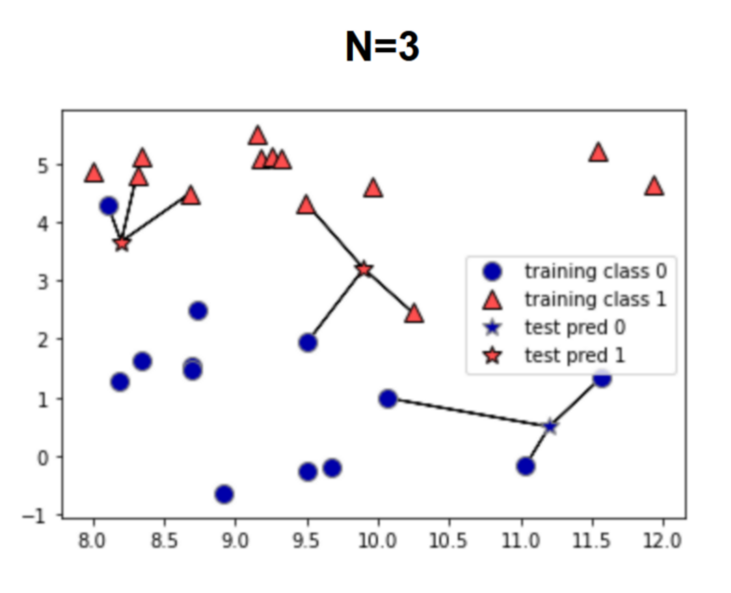
Classifiers Review
Classifier
  K-Nearest Neighbors
    Uses K classes close by to guess what this data point is

Slide 24
Classifiers Review
Classifier
  Decision Trees
    Splits data into a specified number of boundaries (leaves).
      Maximizes either entropy or gini score to determine split boundary.
    Sensitive to orientation of data
      Data works best if orthogonal (90°) to axis of data

Slide 25
Classifiers Review
Classifier
  Decision Trees
    Tends to overfit the data
      Choose parameters to reduce this issue
    Can determine feature importances

Slide 26
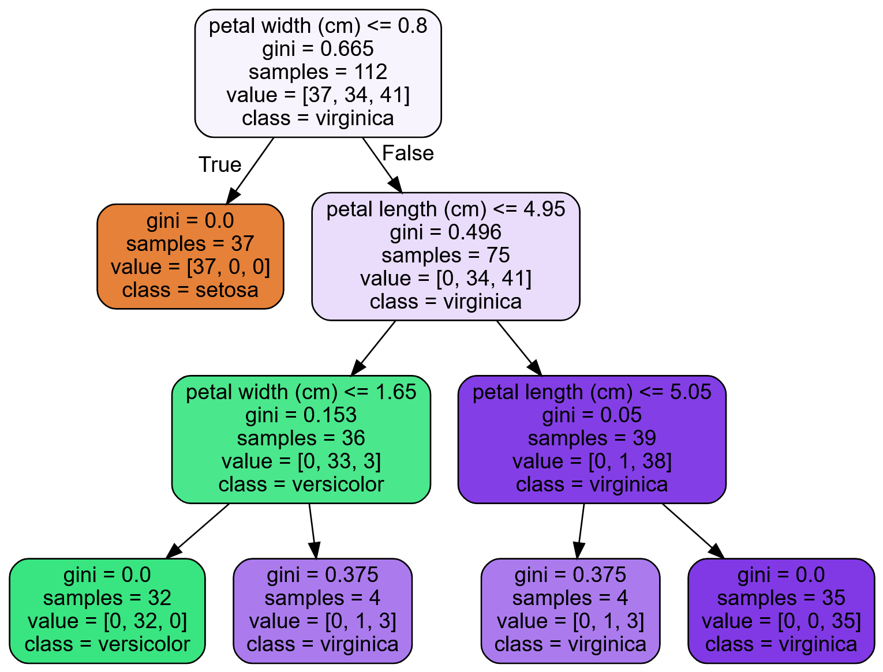
Classifiers Review
Classifier
  Decision Trees

Slide 27
Classifiers Review
Classifier
  Logistic Regression
    Guesses probabilities of whether each data point is the positive class.
      If over 50%, then that data point is the class.
    Can only be used for binary classification.

Slide 28
Classifiers Review
Classifier
  Logistic Regression
    Regularization parameter c
      Higher value causes the model to fit the training data more closely
        Less regularized, less general
      Can choose either L2 (default) or L1 regularization

Slide 29
Classifiers Review
Classifier
  Linear Support Vector Machines (SVM)
    Attempts to create decision boundaries that maximize the space between the two closest samples.

Slide 30
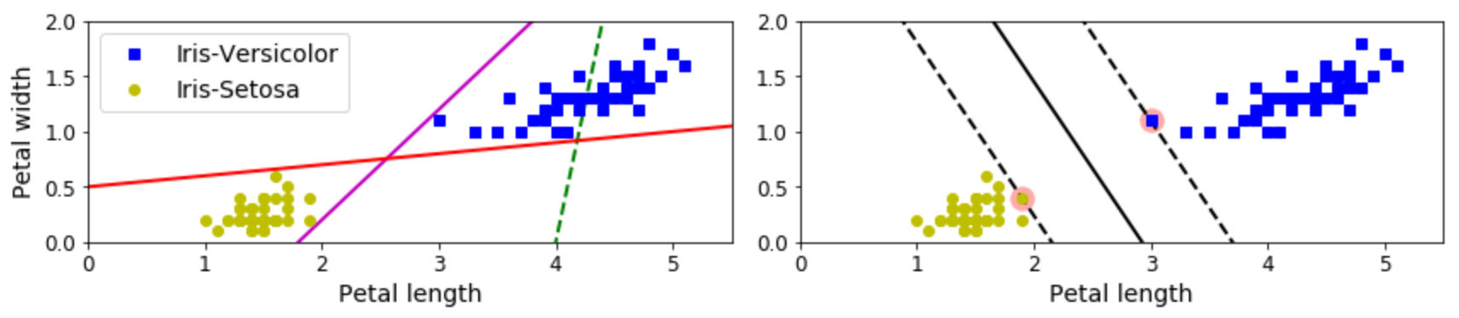
Classifiers Review
Classifier
  Linear Support Vector Machines (SVM)
    Attempts to create decision boundaries that maximize the distance between the two closest samples.
(4)

Slide 31
Classifiers Review
Classifier
  Linear Support Vector Machines (SVM)
    Regularization
      Linear SVM’s use the c hyperparameter
      The c value changes the width of the margins from the boundary condition
      Smaller c values increase the margins, which generalizes more

Slide 32
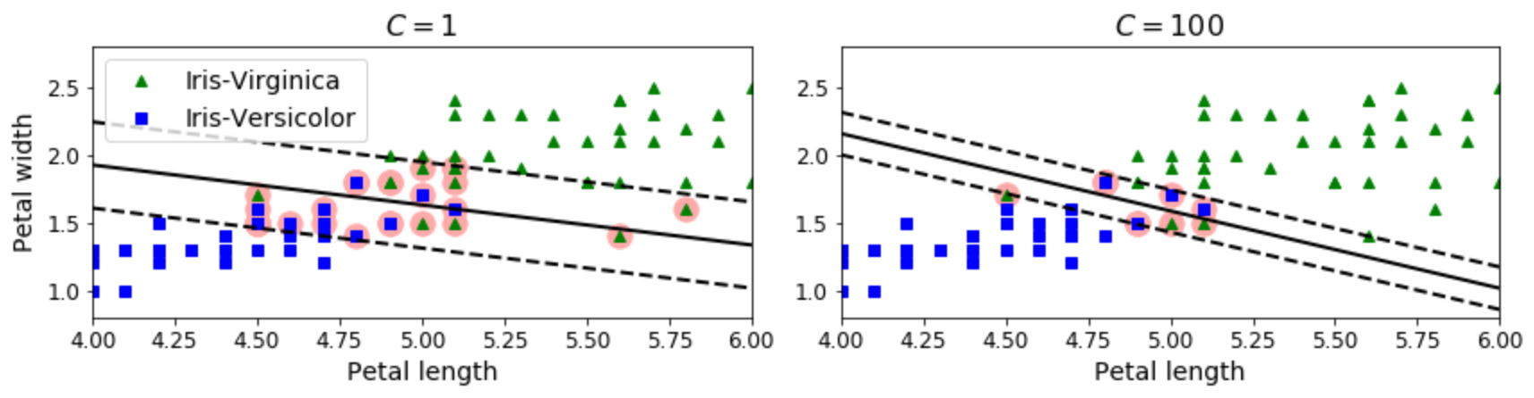
Classifiers Review
Classifier
  Linear Support Vector Machines (SVM)
    Regularization
(4)

Slide 33
Classifiers Review
Classifier
  Non-linear Support Vector Machines (SVM)
    Uses feature engineering to increase number of dimensions
      Allows for a linear hyperplane in the next-higher dimension space

Slide 34
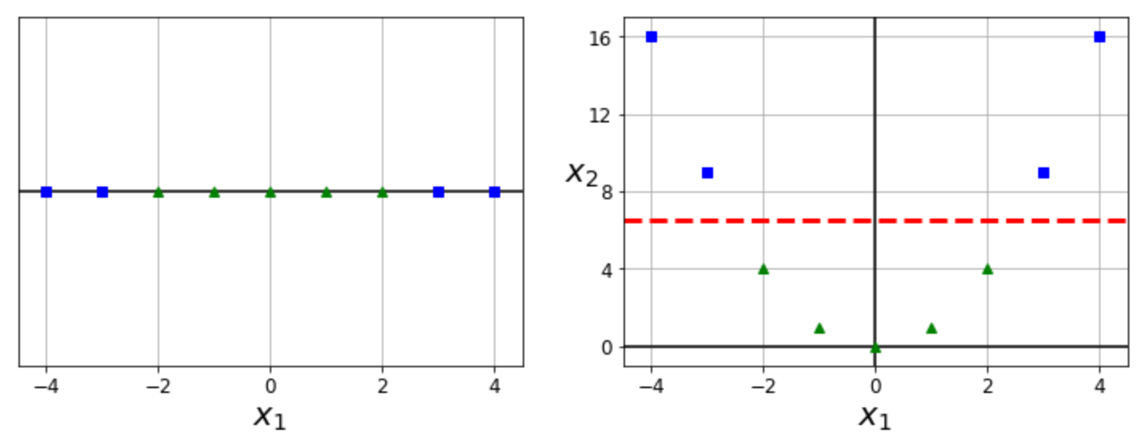
Classifiers Review
Classifier
  Non-linear Support Vector Machines (SVM)
(4)

Slide 35
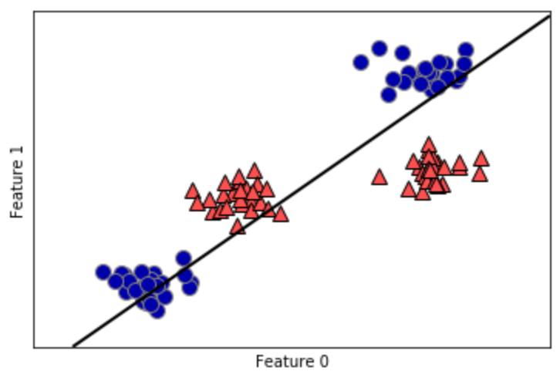
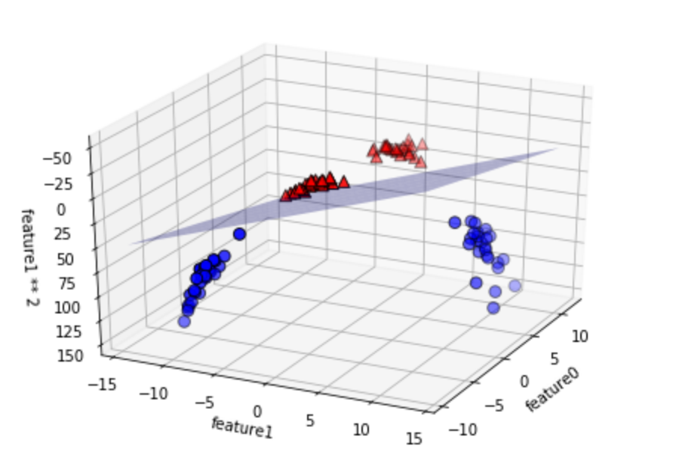
Classifiers Review
Classifier
  Non-linear Support Vector Machines (SVM)
(1)

Slide 36
Classifiers Review
Classifier
  Non-linear Support Vector Machines (SVM)
    Creates new features via kernels
      Polynomial function
      Similarity function
        Gaussian Radial Basis Function (land marks)

Slide 37
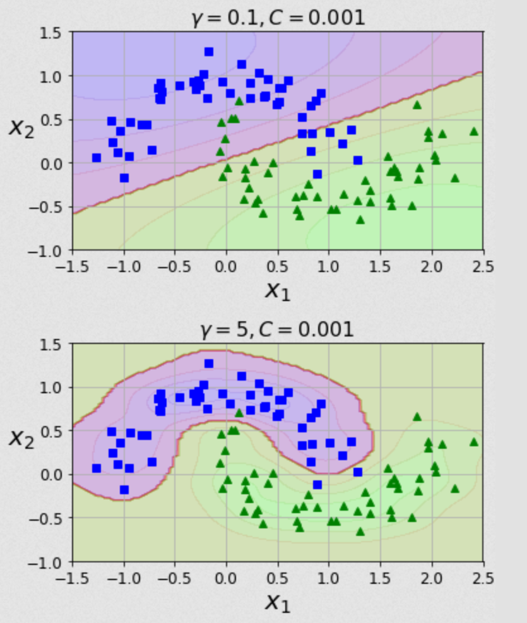
Classifiers Review
Classifier
  Non-linear Support Vector Machines (SVM)
    Regularization
    parameter λ used
    for RBF
(4)

Slide 38
Classifiers Review
Classifier
  Ensemble Methods
    Voting Classifier
      Train multiple classifiers, and estimate the target based on majority vote from all classifiers.

Slide 39
Classifiers Review
Classifier
  Ensemble Methods
    Bagging and Pasting
      Same trainer is used multiple times
      A random set of the data is chosen for each trainer
      Bagging allows for the same data point to be used across multiple trainers
      Pasting does not allow the same data point to be used across multiple trainers

Slide 40
Classifiers Review
Classifier
  Ensemble Methods
    Random Forest
      A collection of decision trees trained on randomly chosen data points.
        Bagging method with decision trees.

Slide 41
Classifiers Review
Classifier
  Ensemble Methods
    AdaBoost
      Sequentially train models.
      Each model has increased weights on the data points the previous model underfitted.

Slide 42
Classifiers Review
Classifier
  Ensemble Methods
    Gradient Boosted Forest
      Sequentially train decision tree models.
      Each model uses the residuals of the previous model as the weights used to train the current model.

Slide 43
Classifiers Review
Metrics
  An accuracy score doesn’t tell the whole story. Depending on the type of data we have and what we are trying to estimate, we may want to err on one side or the other.
    For cancer detection, we want more false positives than false negatives
    For part survival estimation, we may want more false negatives to ensure slightly more parts are produced.

Slide 44
Classifiers Review
Metrics
  Confusion Matrix
    Each cell shows how many classifications were predicted, and what the actual target was
    Rows are actual targets
    Columns are predicted targets

Slide 45
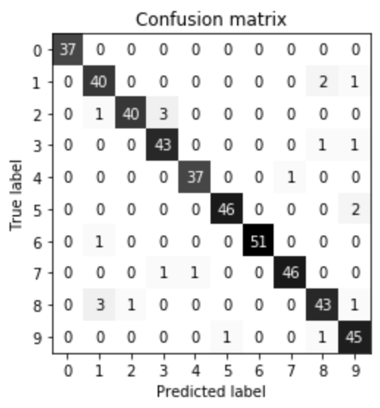
Classifiers Review
Metrics
  Confusion Matrix

Slide 46
Classifiers Review
Metrics
  Precision Recall Curves
    Precision
      TP/(TP+FP)
      Correctly guessed classes over total number of instances guessed as the positive class
    Recall
      TP/(TP+FN)
      Correctly guessed classes over total number of data points that are the positive class

Slide 47
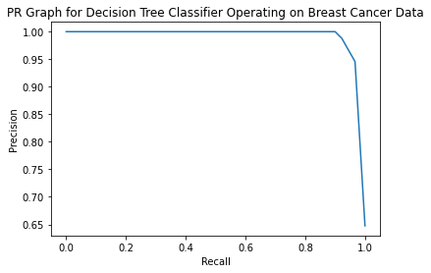
Classifiers Review
Metrics
  Precision Recall Curves

Slide 48
Classifiers Review
Metrics
  Precision Recall Curves
    Precision recall trade off
      Increasing one decreases the other
      Cannot have both

Slide 49
Classifiers Review
Metrics
  Receiver Operating Characteristics (ROC) Curve
    Plots True Positive Rate vs False Positive Rate.
    Points further to the upper left corner are more accurate at making predictions.

Slide 50
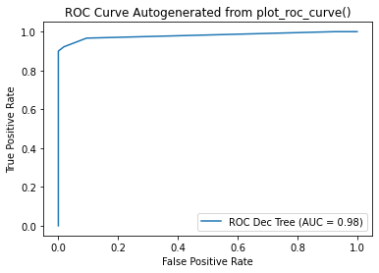
Classifiers Review
Metrics
  Receiver Operating Characteristics (ROC) Curve

Slide 51
Classifiers Review
Metrics
  Area Under the Curve (AUC)
    Area under the ROC curve
    1 represent a perfect classifier
    0.5 represent a purely random classifier

Slide 52
Classifiers Review
Review Program
  Go over in-class problem.

Slide 53

Classifiers Review
In-Class Exercise
  Using project data, create and train a model.
    Try scaling
    Try using multiple different trainers
    Use different evaluation metrics appropriate to your data

Slide 54

Bibliography
https://github.com/amueller/introduction_to_ml_with_python/blob/master/02-supervised-learning.ipynb
Müller, A. C., & Guido, S. (2016). Introduction to Machine Learning with Python: A Guide for Data Scientists (1st ed.). O’Reilly Media.
http://rasbt.github.io/mlxtend/user_guide/general_concepts/gradient-optimization/

Slide 55
Bibliography
https://github.com/ageron/handson-ml
Géron Aurélien. Hands-on Machine Learning with Scikit-Learn and Tensorflow. 1st ed., O'Reilly, 2017.
https://machinelearningmastery.com/how-to-use-correlation-to-understand-the-relationship-between-variables/

Slide 56
Bibliography
Harrison, Matt. Machine Learning Pocket Reference: Working with Structured Data in Python. 1st ed., O'Reilly, 2019.
https://scikit-learn.org/stable/modules/cross_validation.html
Scikit-learn: Machine Learning in Python, Pedregosa et al., JMLR 12, pp. 2825-2830, 2011.

Slide 57
Bibliography
API design for machine learning software: experiences from the scikit-learn project, Buitinck et al., 2013.
https://docs.scipy.org/doc/scipy/reference/generated/scipy.stats.pearsonr.html
https://docs.scipy.org/doc/scipy/reference/generated/scipy.stats.spearmanr.html#scipy.stats.spearmanr

Slide 58
Bibliography
https://www.investopedia.com/terms/p/p-value.asp
https://scikit-learn.org/stable/auto_examples/manifold/plot_swissroll.html#sphx-glr-auto-examples-manifold-plot-swissroll-py
https://scikit-learn.org/stable/auto_examples/manifold/plot_compare_methods.html#sphx-glr-auto-examples-manifold-plot-compare-methods-py

Slide 59
Bibliography
16) https://wizardforcel.gitbooks.io/scikit-and-tensorflow-workbooks-bjpcjp/content/ch08-dimensionality-reduction.html
17) https://pub.towardsai.net/principal-component-analysis-in-dimensionality-reduction-with-python-1a613006d531
18) https://towardsdatascience.com/the-kernel-trick-c98cdbcaeb3f

Slide 60
Bibliography
19) https://cs.nyu.edu/~roweis/lle/papers/lleintro.pdf
20)https://docs.python.org/3/library/json.html
21)https://academic.oup.com/bioinformatics/article/24/18/2010/190849?login=false
22)https://arxiv.org/pdf/1904.10416.pdf
23)

Slide 61
Additional Resources
https://towardsdatascience.com/over-fitting-and-regularization-64d16100f45c
https://towardsdatascience.com/scale-standardize-or-normalize-with-scikit-learn-6ccc7d176a02

Slide 62
LICENSE
Copyright 2022 Douglas Bowman
Permission is hereby granted, free of charge, to any person obtaining a copy of this software and associated documentation files (the "Software"), to deal in the Software without restriction, including without limitation the rights to use, copy, modify, merge, publish, distribute, sublicense, and/or sell copies of the Software, and to permit persons to whom the Software is furnished to do so, subject to the following conditions:
The above copyright notice and this permission notice shall be included in all copies or substantial portions of the Software.
THE SOFTWARE IS PROVIDED "AS IS", WITHOUT WARRANTY OF ANY KIND, EXPRESS OR IMPLIED, INCLUDING BUT NOT LIMITED TO THE WARRANTIES OF MERCHANTABILITY, FITNESS FOR A PARTICULAR PURPOSE AND NONINFRINGEMENT. IN NO EVENT SHALL THE AUTHORS OR COPYRIGHT HOLDERS BE LIABLE FOR ANY CLAIM, DAMAGES OR OTHER LIABILITY, WHETHER IN AN ACTION OF CONTRACT, TORT OR OTHERWISE, ARISING FROM, OUT OF OR IN CONNECTION WITH THE SOFTWARE OR THE USE OR OTHER DEALINGS IN THE SOFTWARE.

